Slide 1
Amira / Small FL tests

Slide 2
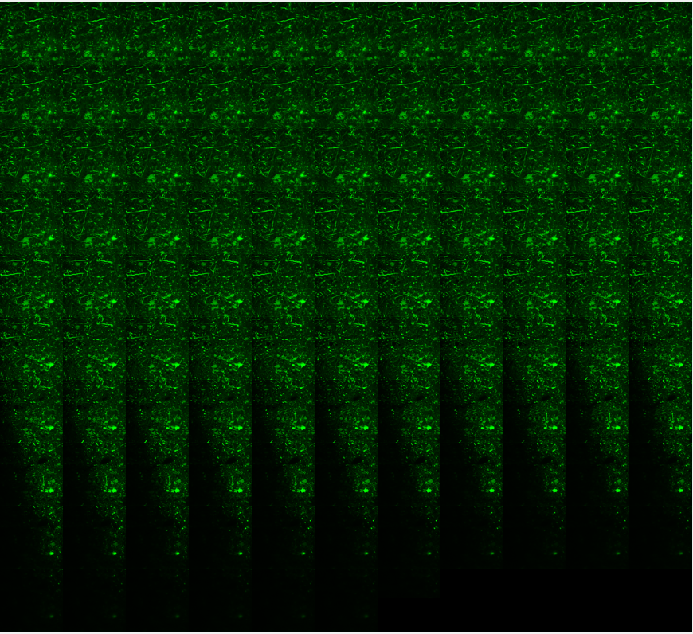
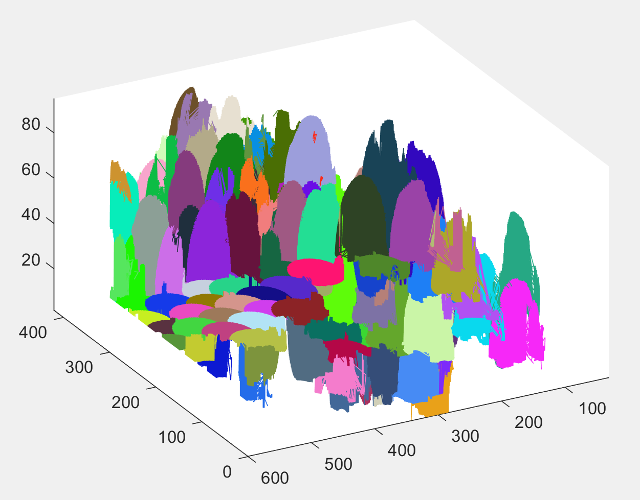
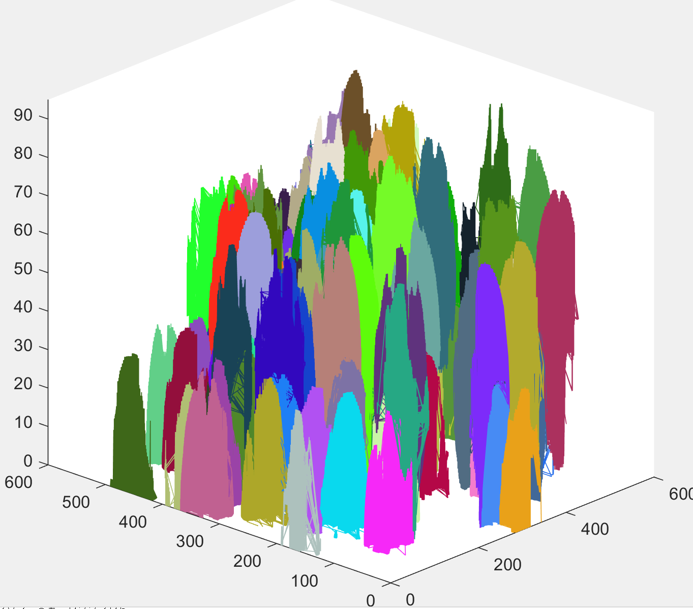
Original FL Zee stack
fibers = FiberFinder(depth, height, width, imgArray, 13, 50, 5, 20, 30);

Slide 3
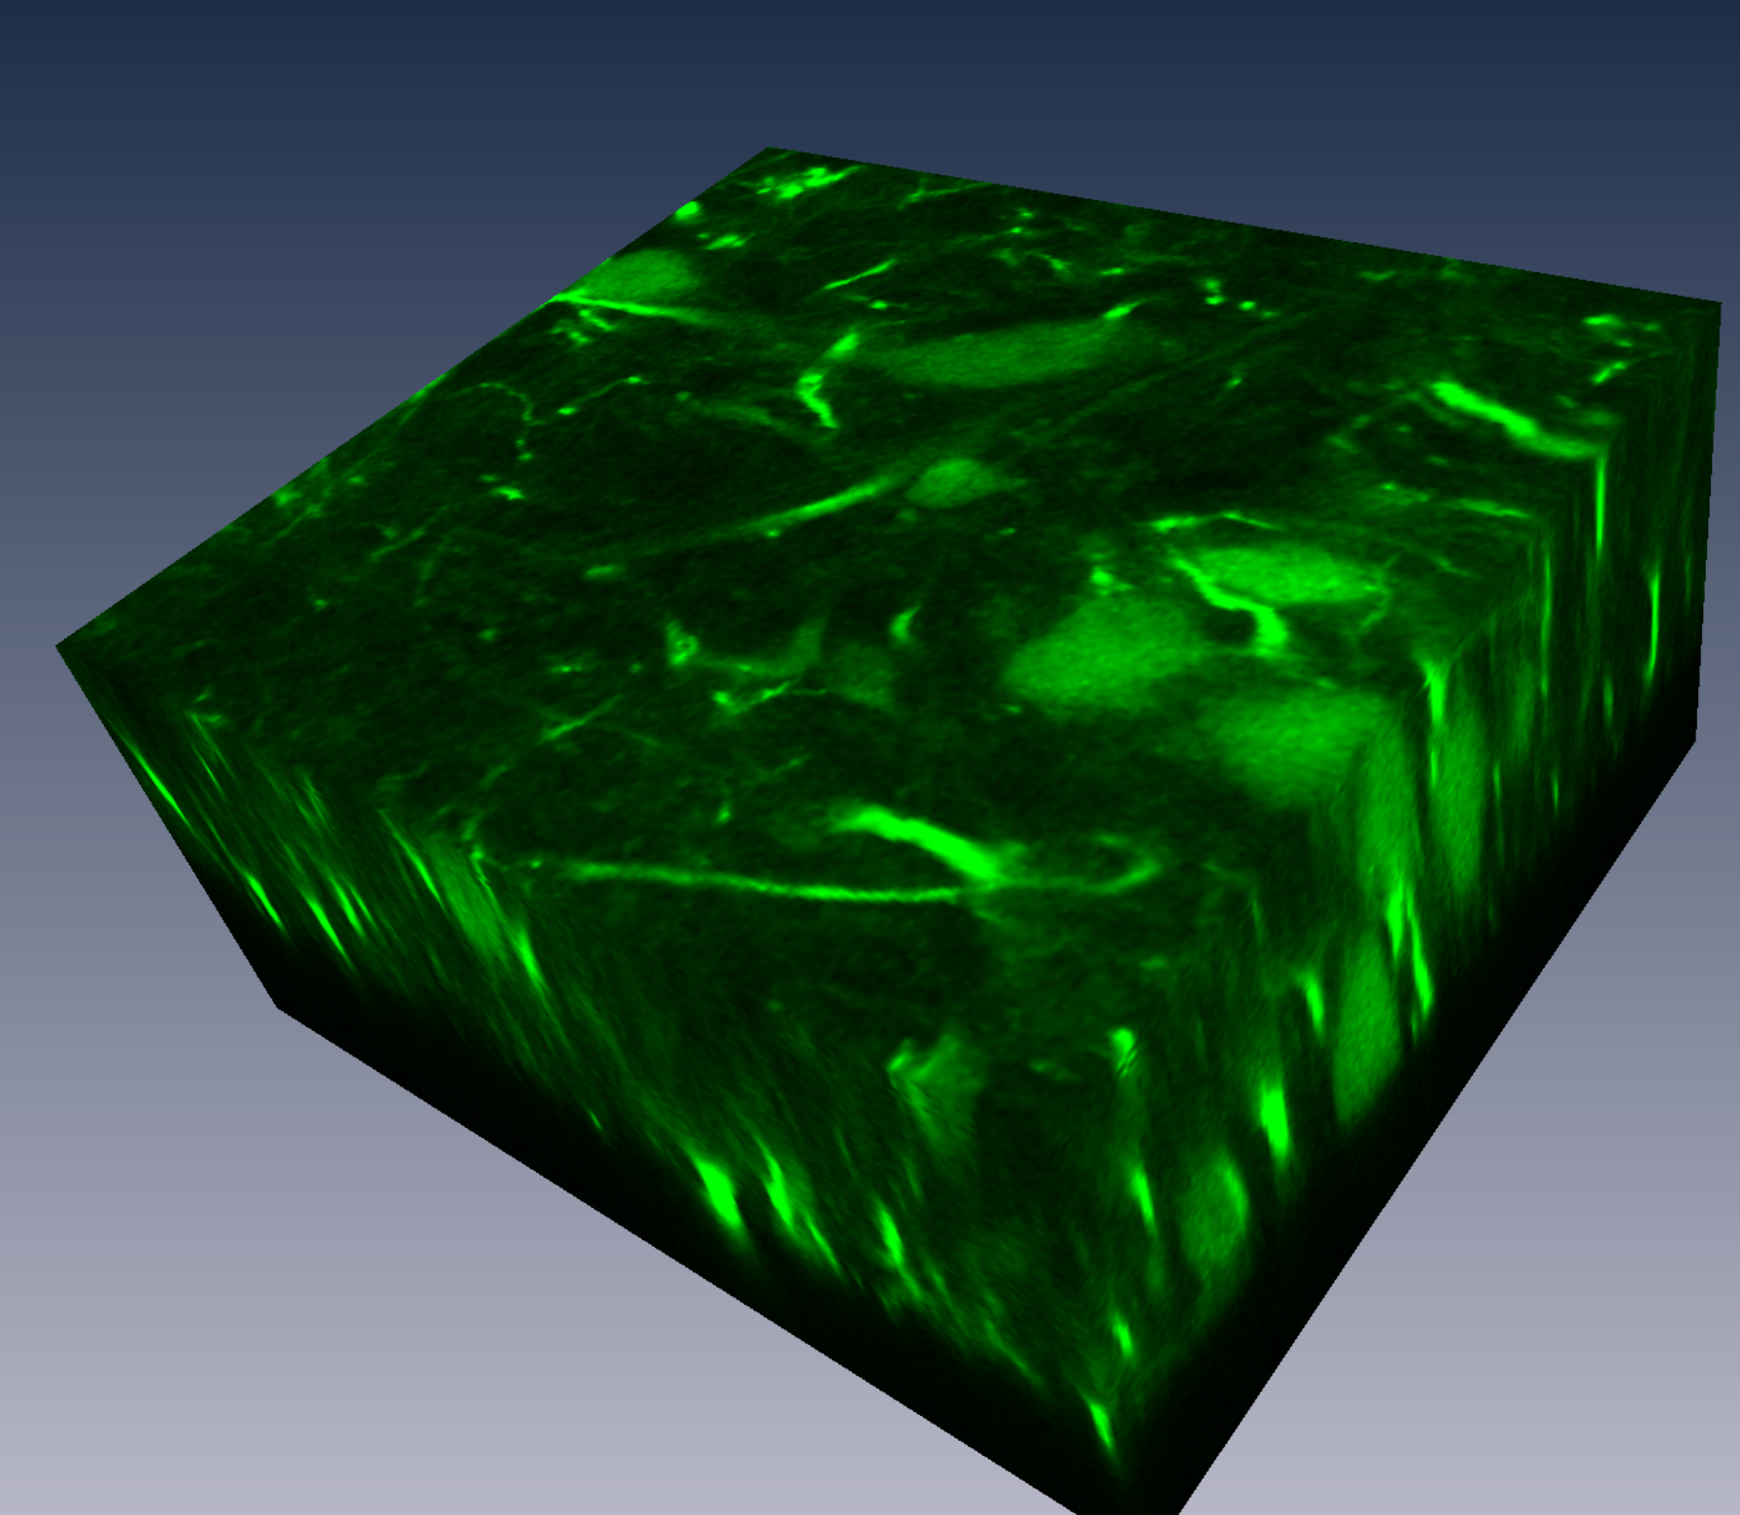
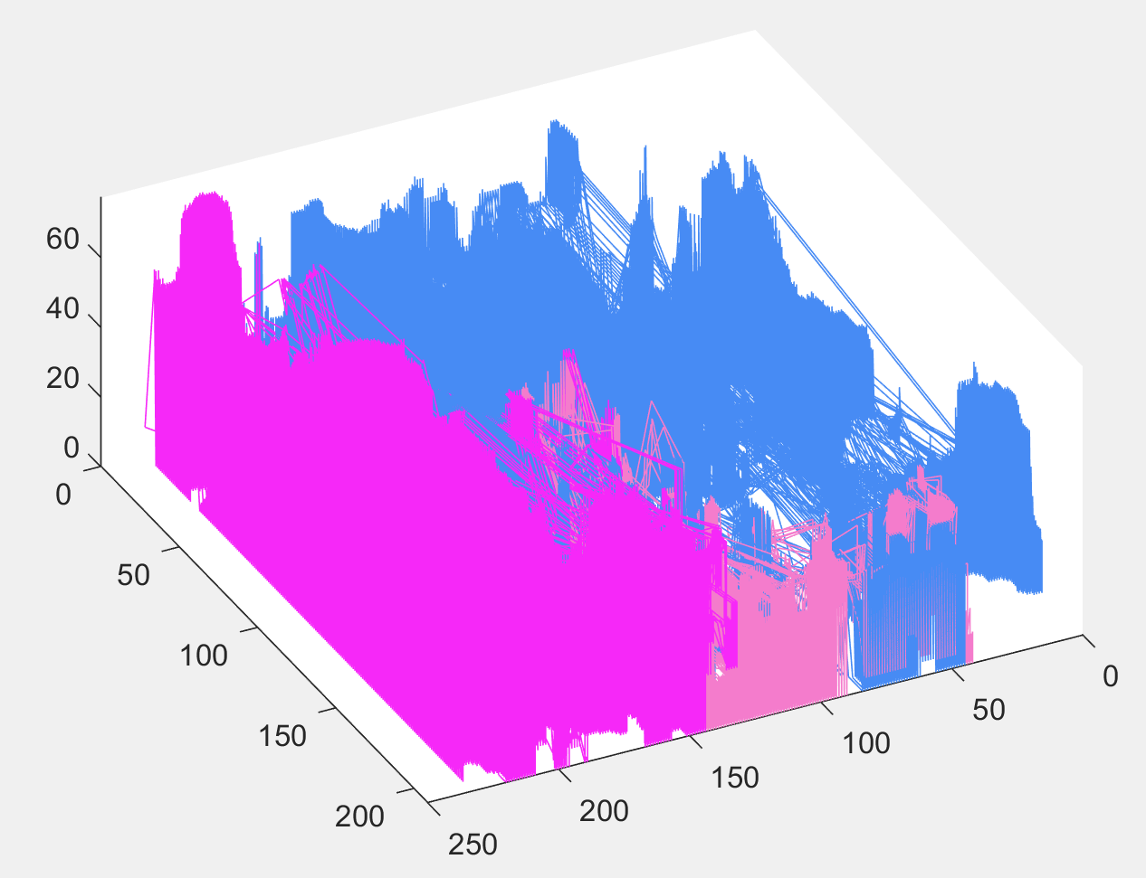
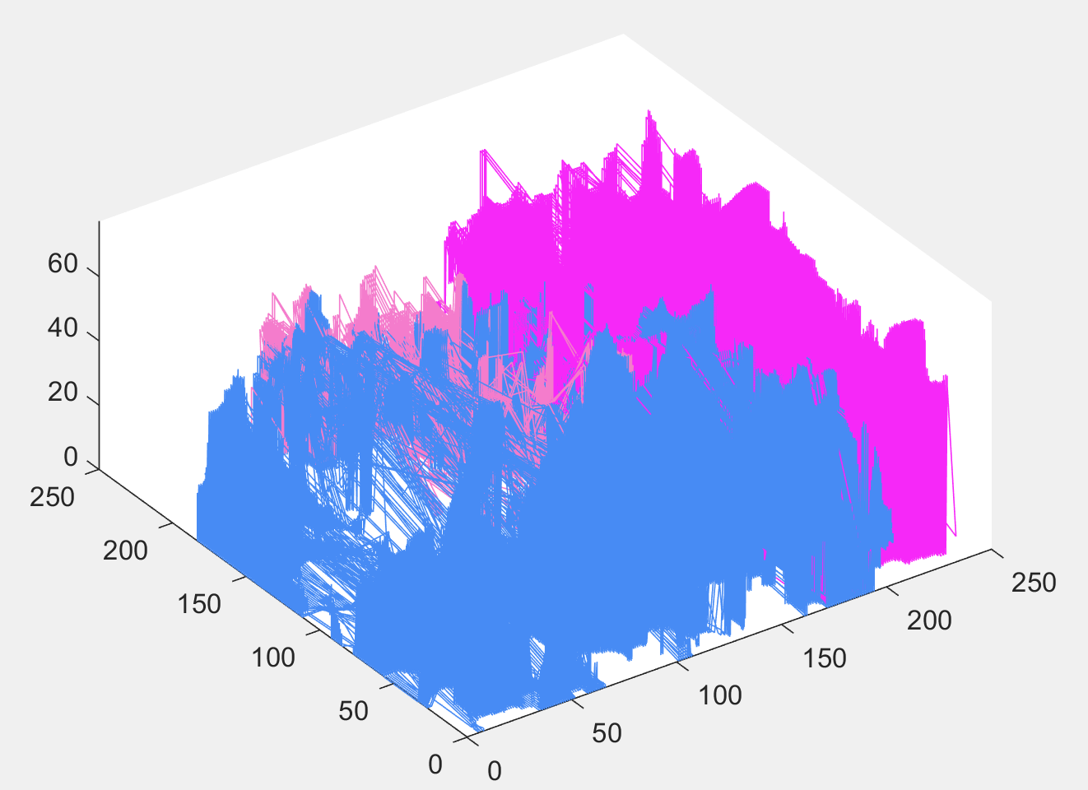
FL Zee stack
DFS size of 2 did not even finish overnight.
Lots of issues with plotting time, took 15 min for fibers but 45 min to plot
Increasing DFS sized increased performance, but reduced result quality.
Need to play with Nucleation point threshold, LMP threshold.
Have to modify algorithm/parameters to work with small crops.

Slide 4
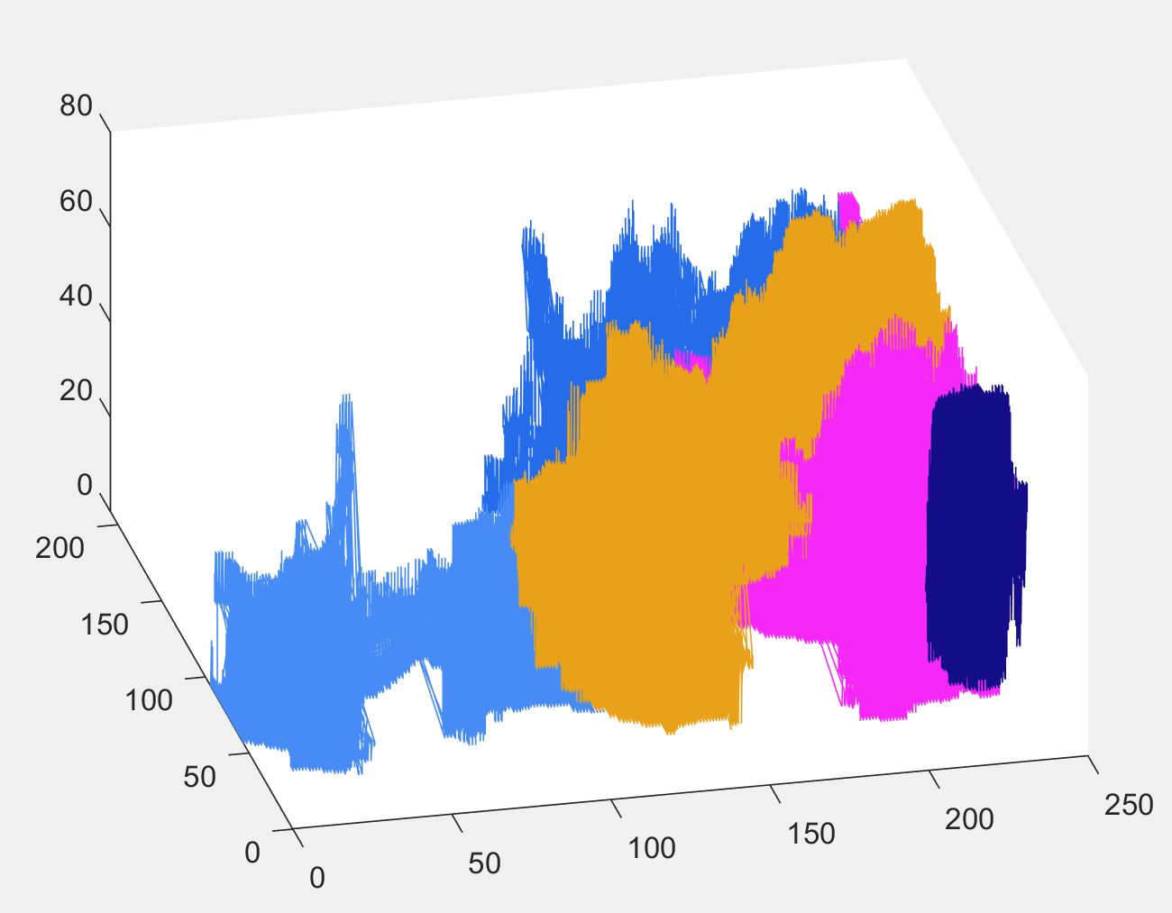
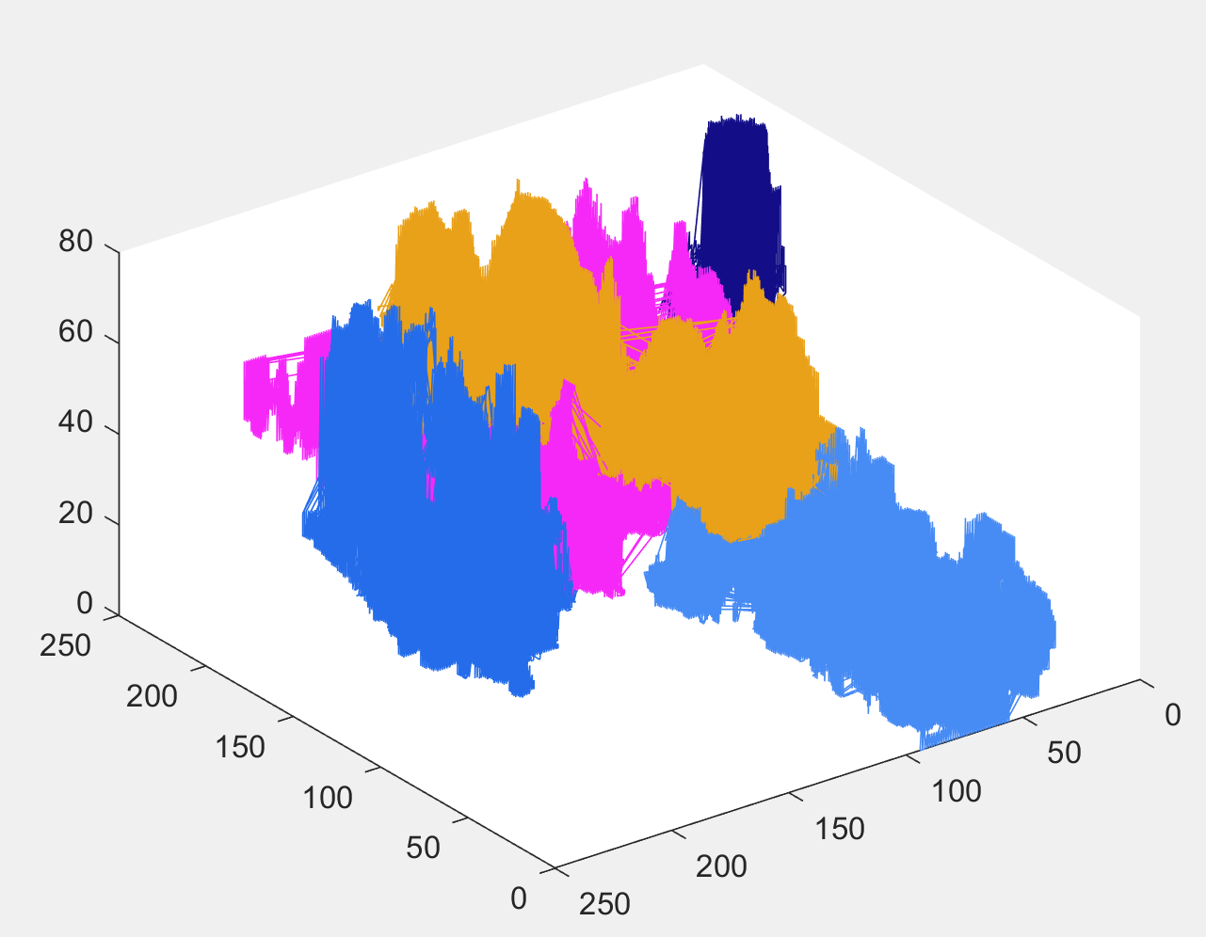
FL Zee stack, modified params
Decreased tMax fiber length to avg(width, depth, height) / 10
Changed DFS depth to avg(width, depth, height)/lmpBoxRadius
Found 20 – 30 fibers
Added points whose minimum distance is outside of radius to search to background pixel to be radius to search in
fibers = FiberFinder(depth, height, width, imgArray, 20, 10, 2, 2, 5);

Slide 5
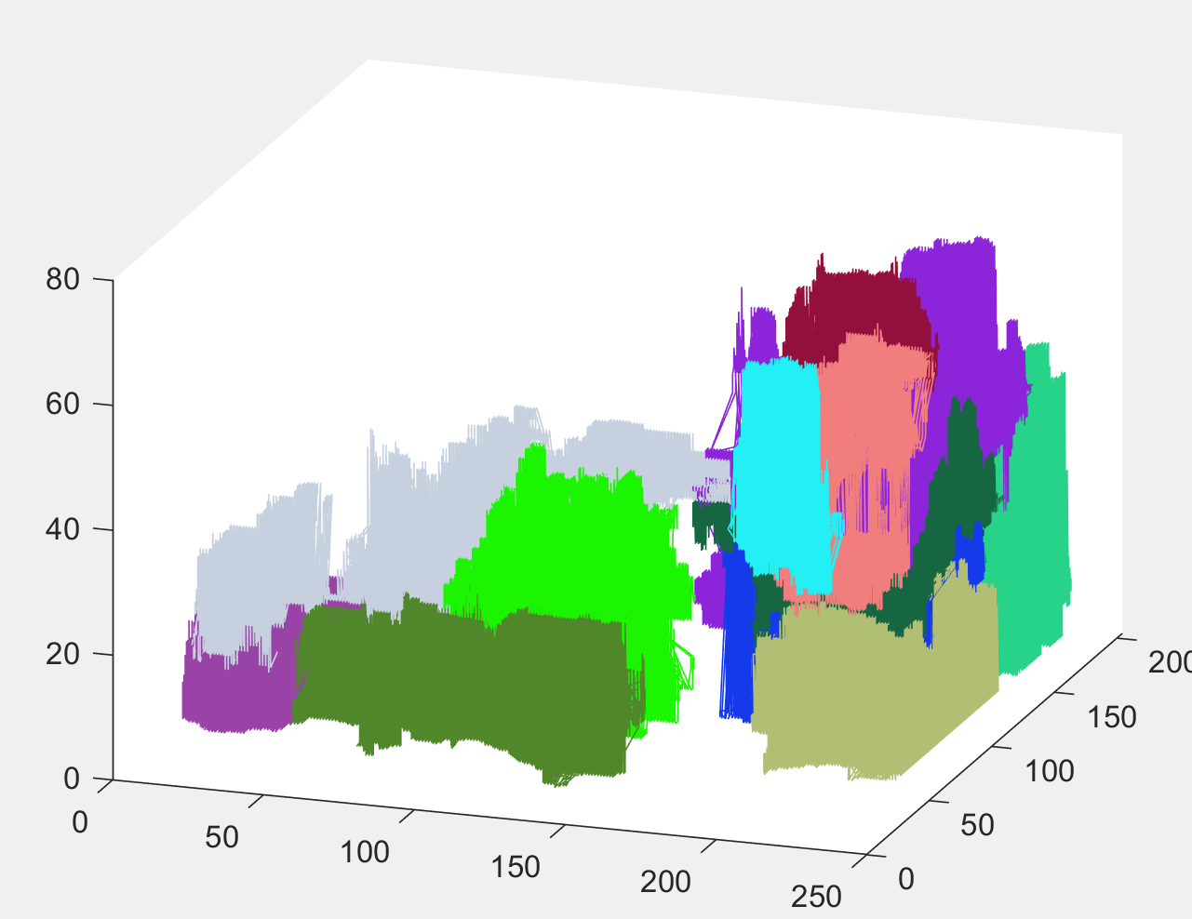
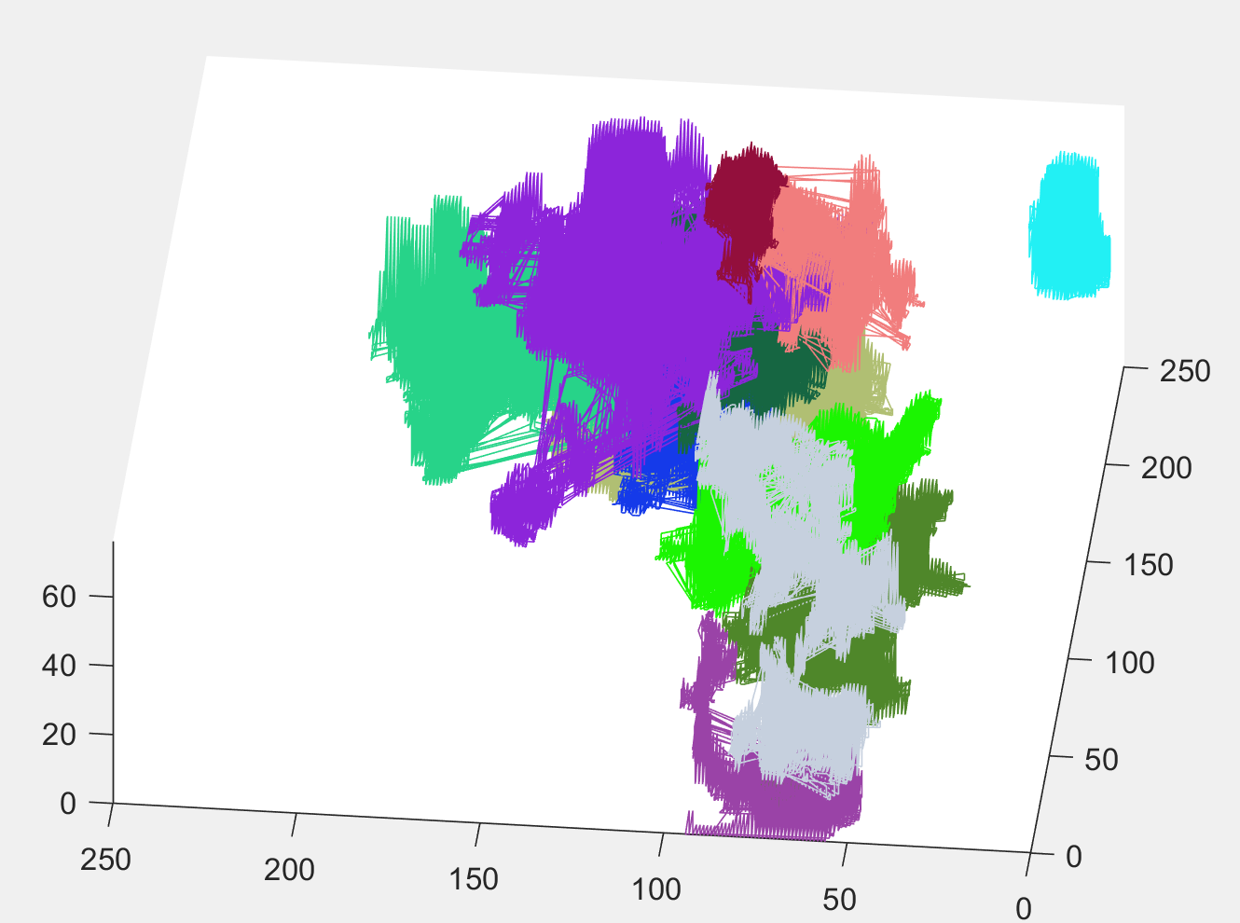
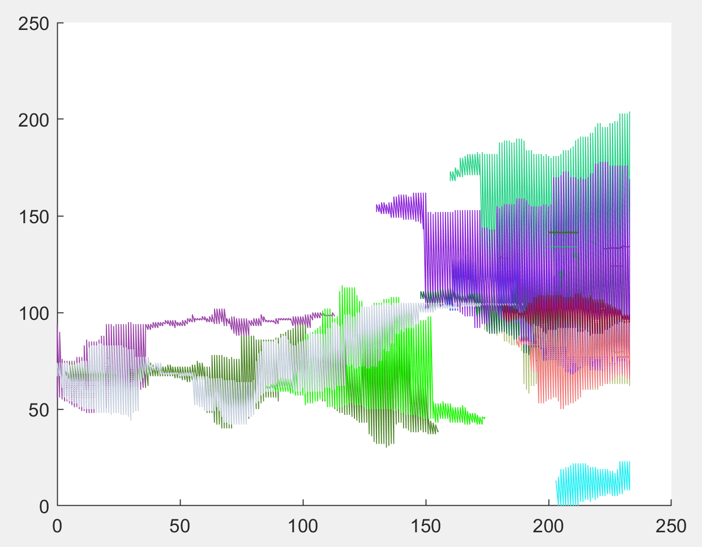
FL Zee stack, modified params
fibers = FiberFinder(depth, height, width, imgArray, 20, 10, 2, 1, 5);

Slide 6
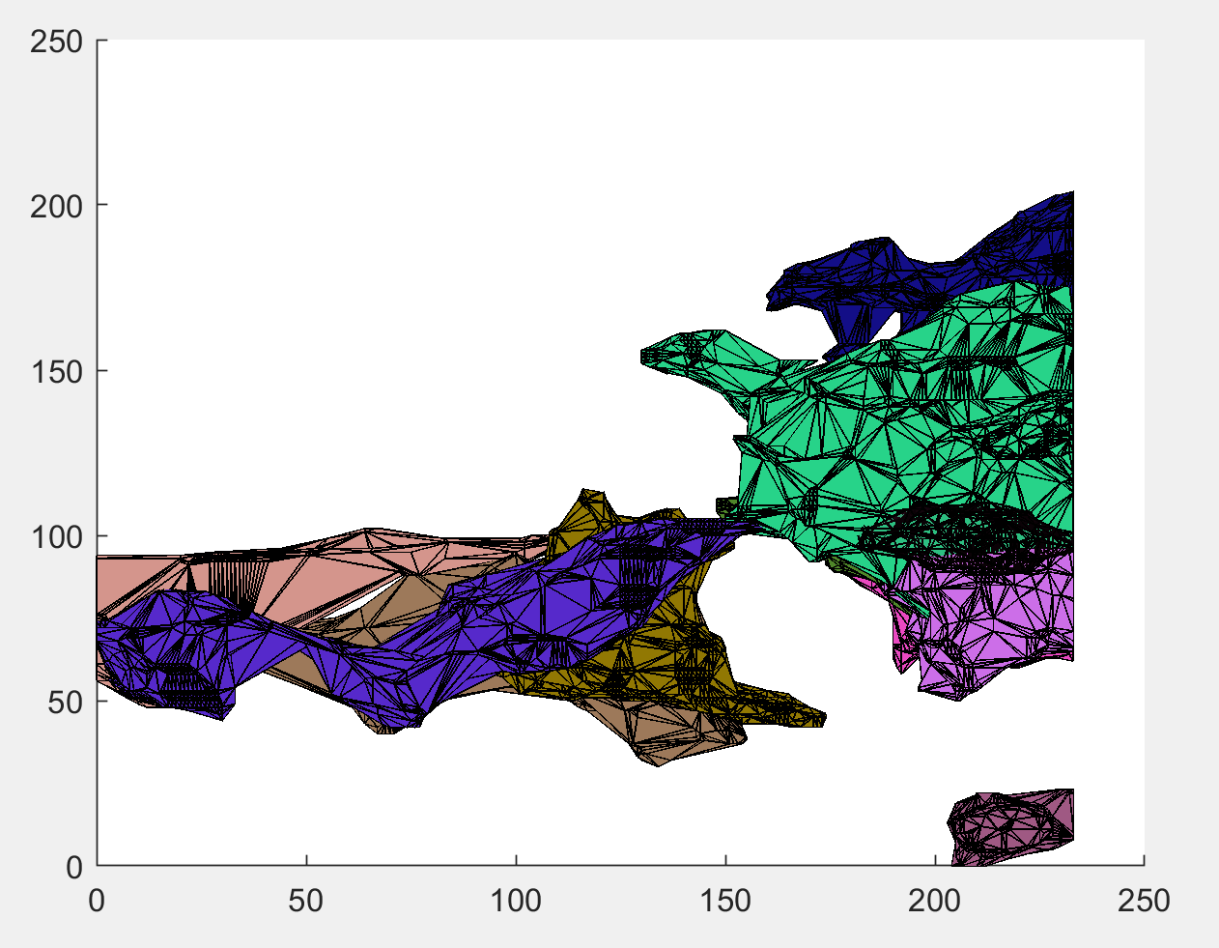
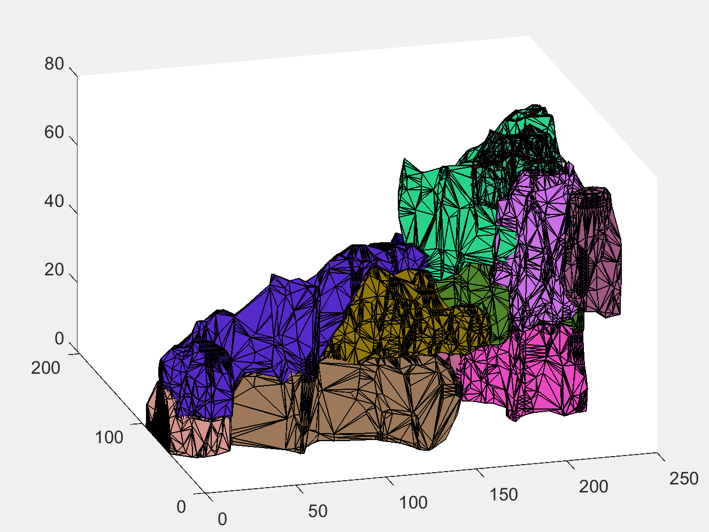
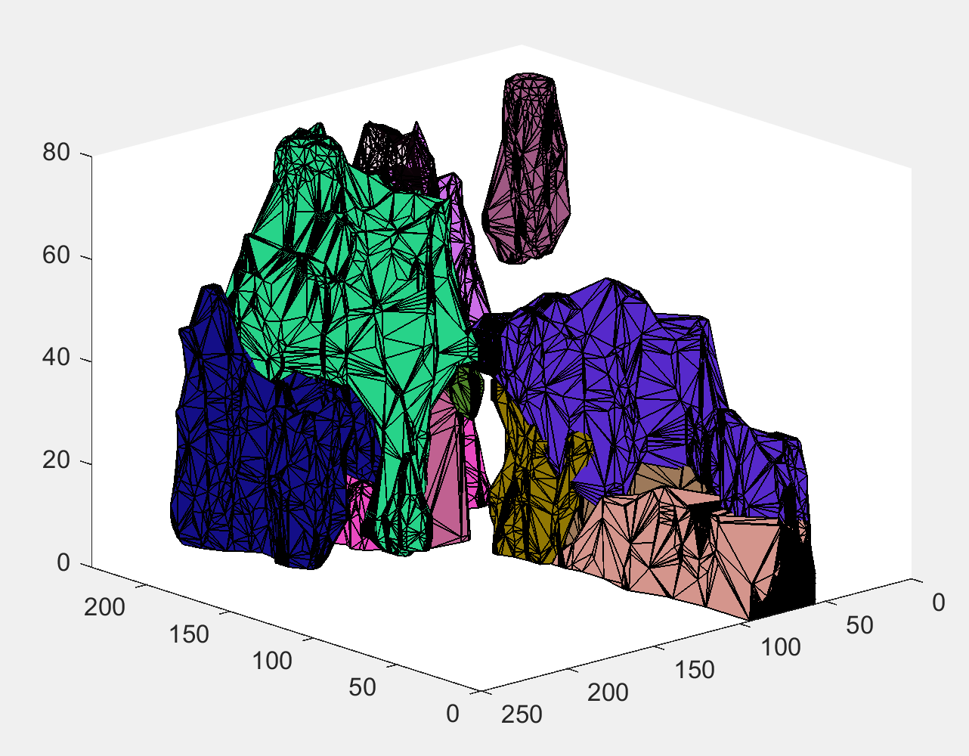
FL Zee stack, boundary modified params
fibers = FiberFinder(depth, height, width, imgArray, 20, 10, 2, 1, 5);

Slide 7
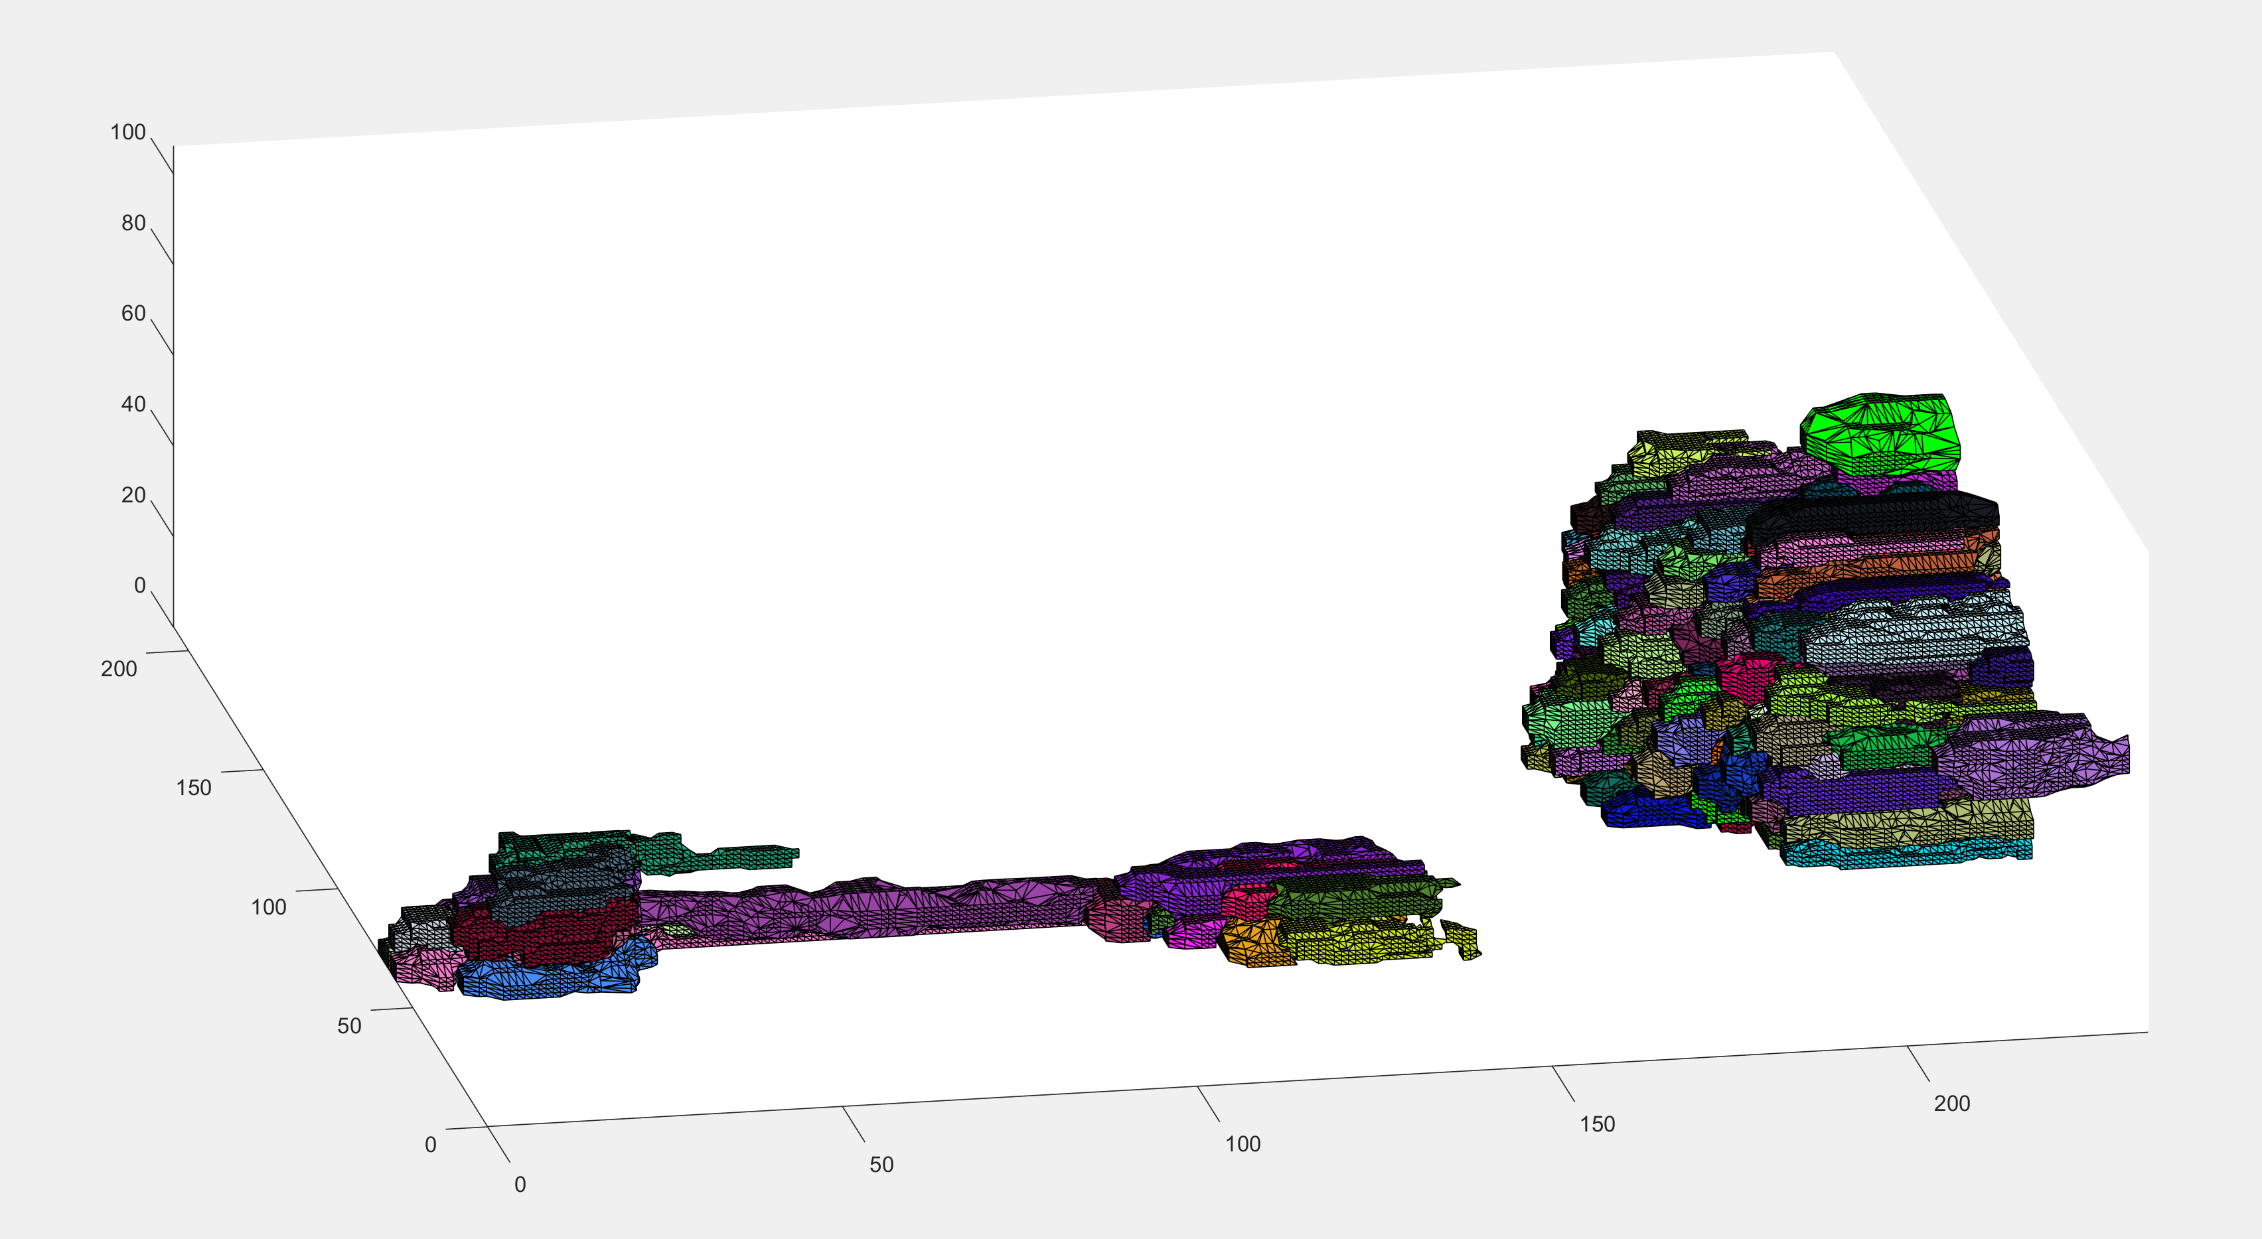
FL Zee stack, boundary modified params
fibers = FiberFinder(depth, height, width, imgArray, 20, 10, 2, 1, 5);
Dfs depth = 7

Slide 8
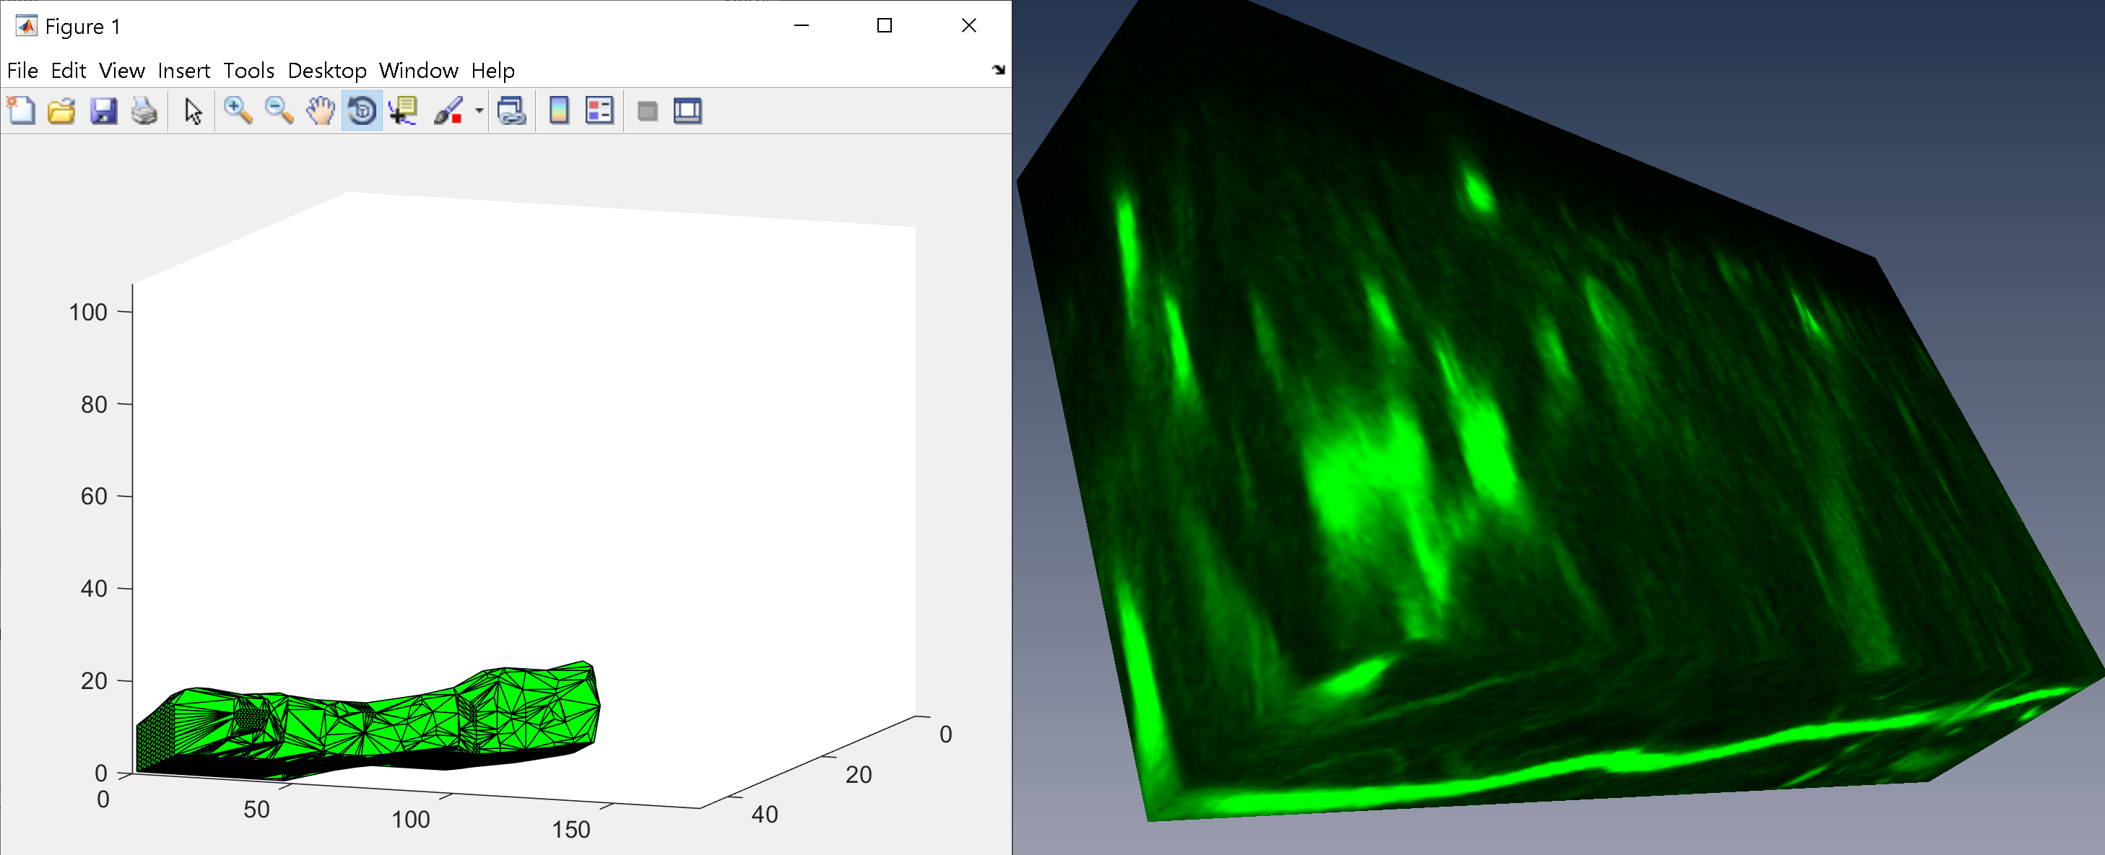
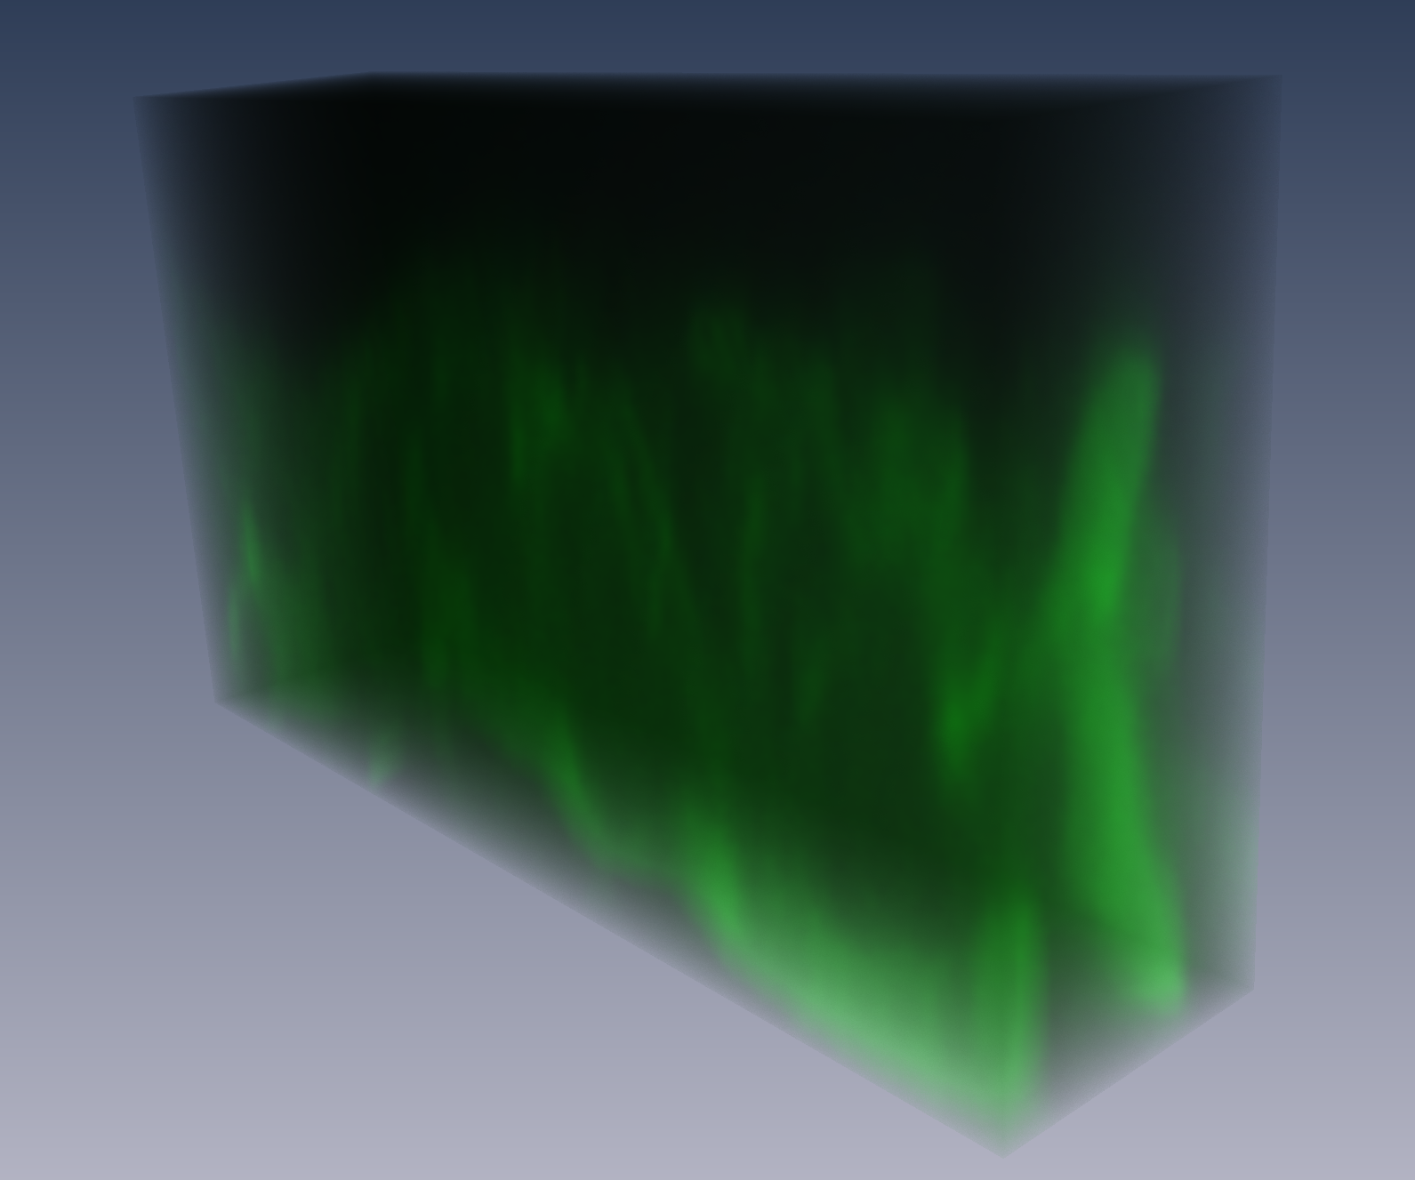
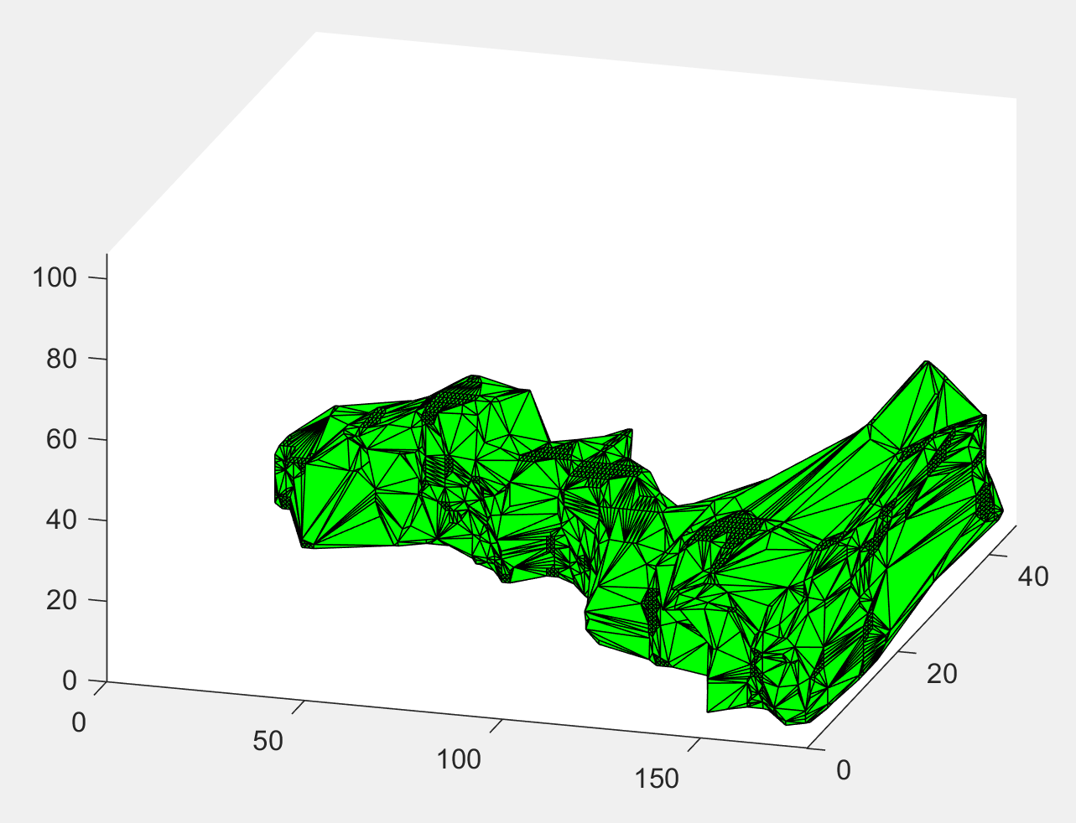
Straight fiber line
fibers = FiberFinder(depth, height, width, imgArray, 20, 10, 2, 1, 5)
Thresholding is very high
Changed max fiber length to be width, since its largest parameter. Average doesn’t work if there is a large difference in x, y, and z

Slide 9
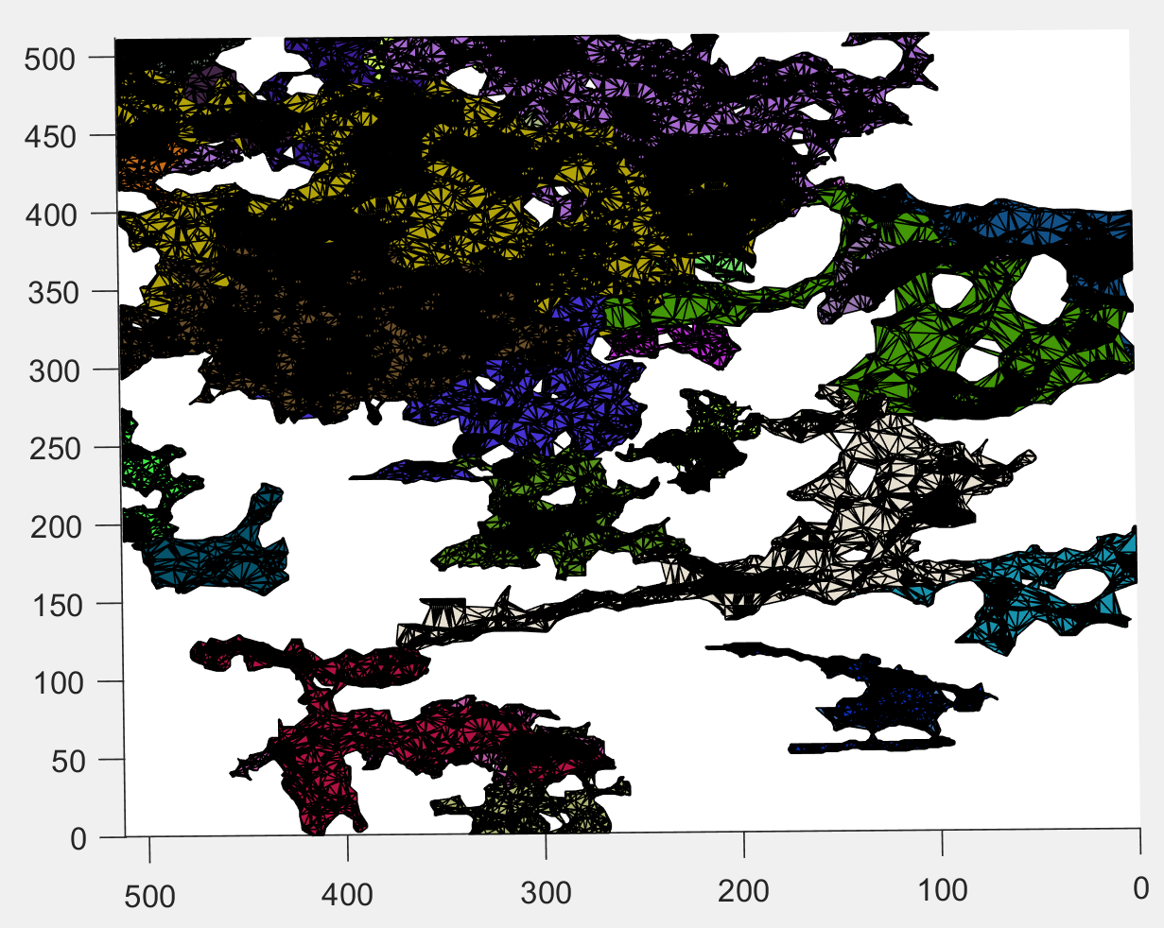
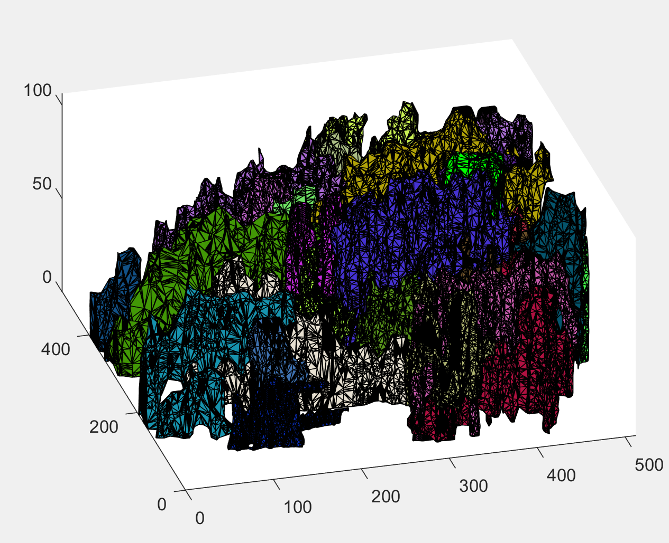
Original FL Zee stack
Fibers = FiberFinder(depth, height, width, imgArray, 20, 10, 2, 1, 5);
Found 66 fibers
Took 64 min
this->maxDFSDepth = this->maxFiberLength / lmpBoxRadius;

